Slide 1

Software engineering Leave management system
Under the guidance of
Dr.Sheikh Fahad Ahmad Sir.

Slide 2
TEAM MEMBERS
2110030054
PILLI VAISHNAVI
2110030203
MANISRI
2110030218
NAVYA
2110030233
RISHIKA

Slide 3

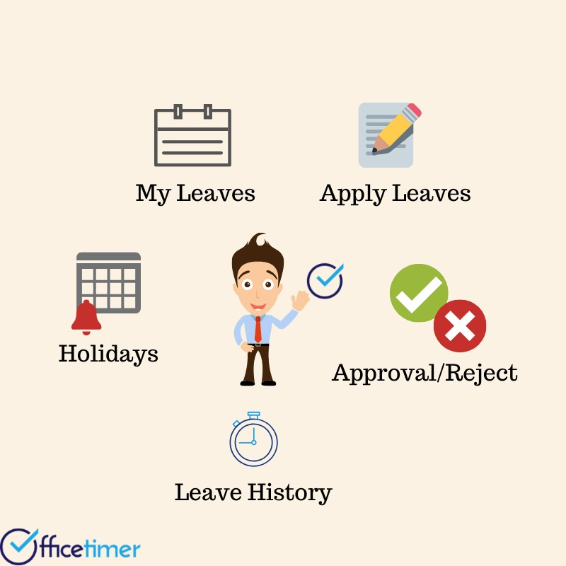
WHAT IS LEAVE MANAGEMENT SYSTEM
A leave management system is a unified platform that manages all the employee leave and vacation-related activities in single software or solution. It streamlines the entire process and saves a lot of time for both employer and employee. It is a cloud-based framework so employees can apply for leave, check to leave status, check balance leave, leave type, and any relevant information from any device and any location. Many professional leave management systems also provide mobile applications to make the process more comfortable. It is a robust solution and has various benefits such as
Eliminates Paperless process
Real-time visibility of the processadditional communication
Saves time and efforts
Secured option
Documentation
Ensures legal compliances

Slide 4
REQUIREMENTS:
USE CASE DIAGRAM IS A GRAPHICAL DEPICTION OF A USER’S POSSIBLE INTERACTION WITH THE SYSTEM. IT SHOWS VARIOUS USE CASES AND DIFFERENT TYPES OF USERS THE SYSTEM HAS.
WE DO USE CASE AND CLASS DIAGRAMS WHICH ARE DONE IN STAR UML SOFTWARE.
IN THE FRONT END WE USE DJANGO IN PYTHON AND MYSQL IN DATA BASE FOR THE BACK END TO SAVE THE USER’S AND ADMIN’S DATA.
WE USE ANY ONE OF THE SOFTWARE ENGINEERING METHODS LIKE LINEAR, EVOLUTIONARY, ITERATIVE, PARALLEL OR PERSPECTIVE MODEL ETC.

Slide 5
Literature review the project is the design and implementation of an interactive World Wide Web-based Leave Management System for the Human Resources Department at Texas A&M University-Corpus Christi. The Leave Management System automates the process of managing and tracking multiple types of employee leaves. Employees are able to submit the leave form, cancel previously submitted leave requests, check the status of leave requests and view completed leave transactions. The Leave Management System maintains a database to keep a running balance of each employees account, accrues employee vacation and sick credits and provides individual reports on employees leave accruals. The researcher learned that in their system the employee can check the leave request status in their leave transactions, keep an accurate records and provide individual report.

Slide 6
SYSTEM MODULES OF LEAVE APPLICATION MANAGEMENT SYSTEM:
Register:
One user has to register on this interface with its actual data to be filled and applied in the same interface, then press enters to be saved in the database. Further, move to log in.
Login:
The user inputs its secure user id and password and enters the system. The user can log in multiple times as many times he wants.
Leave applies:
Here is the module for applying for leave to the interface. One has to enter his details about the leave like the reason for the leave.

Slide 7
Choose the dates of the leave:
Depending upon the user’s account and policy of the company or premise the cost of the leave is calculated and shown to the interface.
Live review:
After successful application of the leave application is will come under scrutiny done by an admin. According to his need, he will review it and take necessary action in the next module.
Leave approval:
Here admin approves the leave or not is reflected by admin to the users. Here all the real-time updates will be shown to the users. Users can see only their own leave requests there.
Log out:
In the end, the user can log out the system to release the resources held for the purpose of anything else.

Slide 8
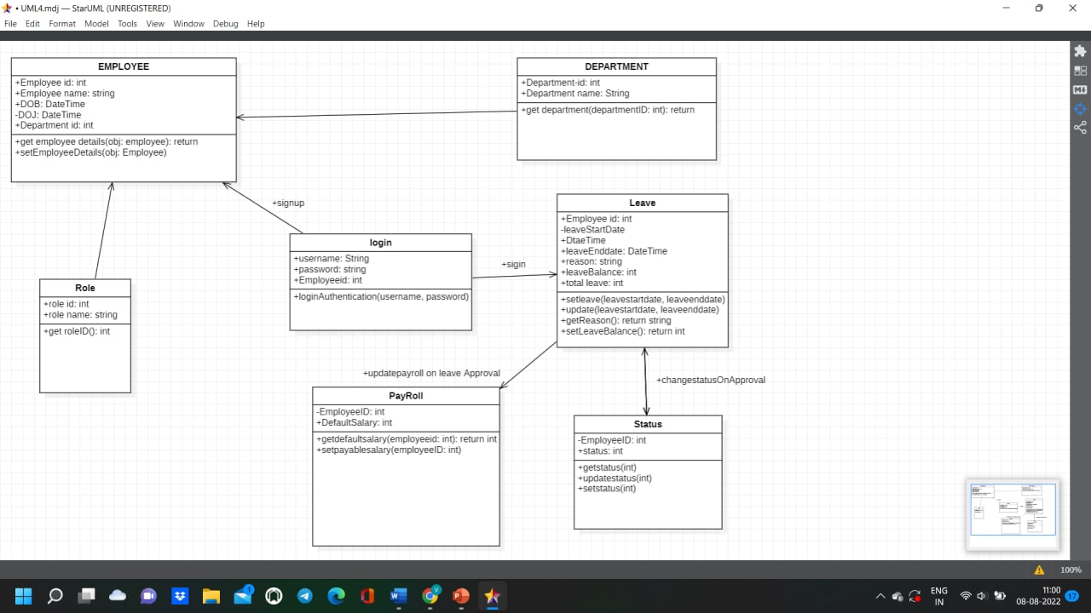
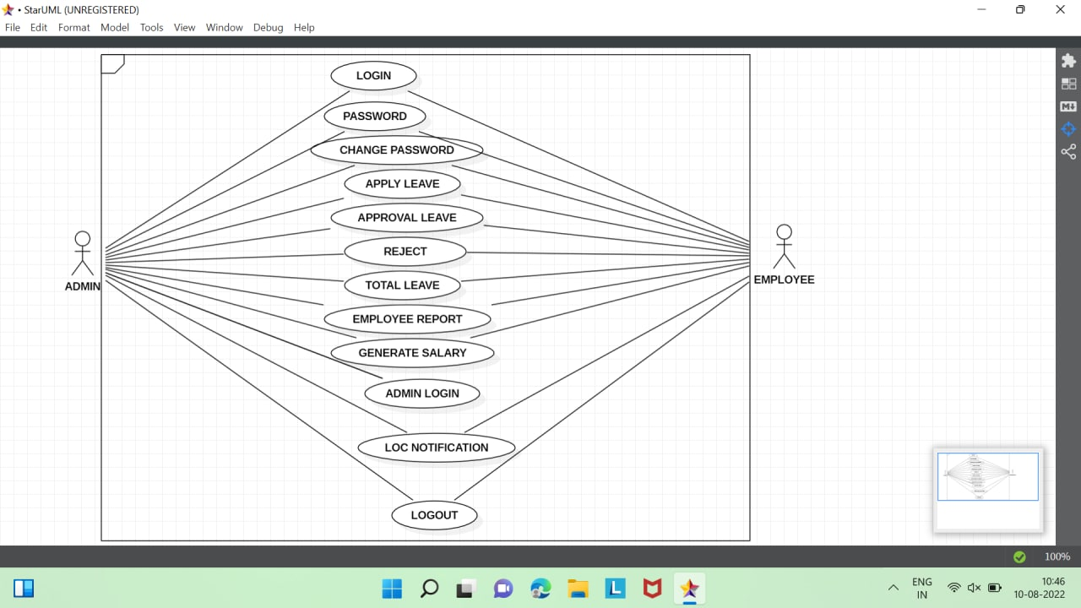
Design modelling diagrams
USECASE DIAGRAM
CLASS DIAGRAM

Slide 9

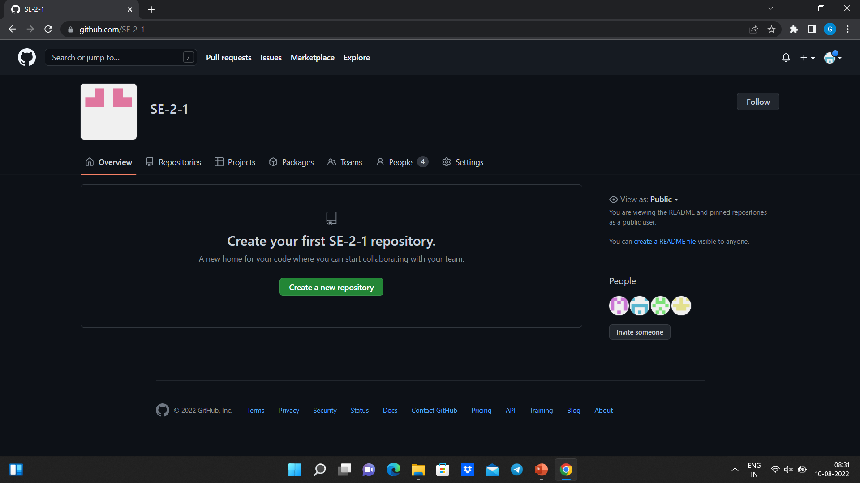
Github setup
https://gith/SE-2-1ub.com

Slide 10
Data set collection
We have done research on various organizations and found that they are facing issues in maintain the record about giving leaves .
So we decided to collect the data from the organizations , conduct surveys and develop this system
This makes it easier for them to manage the leaves of their employees effectively.

Slide 11

Tools required
STAR UML
MY SQL
FLOW CHARTS
CLASS DIAGRAMS
USE CASE DIAGRAMS
PRESPECTIVE METHODS

Slide 12

references
https://www.lovelycoding.org/leave-management-system/
https://razorpay.com/payroll/learn/leave-management-system/
https://www.slideshare.net/muzammilsiddiq/leave-management-system-documentation-44924723
https://factohr.com/leave-management-guide/
https://www.youtube.com/watch?v=g8Qub6twpX4

Slide 13
WORK ALLOCATION TO TEAM MEMBERS:
PILLI VAISHNAVI
BACK END OF APPLICATION USING MYSQL TO STORING THE DATA
MANISRI
UML SETUP AT CENTRAL END OF APPLICATION
NAVYA
FRONT END OF THE APPLICATION USING DJANGO
RISHIKA
REASEARCH AND GATHERING INFORMATION

Slide 14
Thank you

